Slide 1

Sentiment Analysis Using NLP

Slide 2
Contents
Abstract
Introduction
Existing System
Proposed System
Process
Sample input
Sample outputs
References

Slide 3
Abstract
Recommender system is a subclass of information filtering system that seeks to predict the rating or preference that a user would give on an item. Recommender systems are utilizing in a variety of areas including movies, music, news, books, research articles, search queries, social tags, and products in general, jokes, restaurants, garments, financial services, life insurance, and Twitter pages. Natural Language Processing (NLP) for sentiment analysis focused on emotions is extremely useful. The existing system determines ratings based on reviews and the dataset that they choose. The disadvantage is that it generates ratings only for particular dataset that the developer chosen reviews. The proposed system can be determining ratings based on reviews given by the user in universal language (English). The above problem is addressing by using Natural Language Processing techniques. The real-world datasets can be gathered using Amazon datasets which contains review id and reviews.

Slide 4
Introduction
The popularity of mobile devices makes people’s daily lives more dependent on mobile services. People get business information, product information, promotion information, and recommendation information from mobile devices. An important application of mobile services is movie recommendation. A movie recommender system has proven to be a powerful tool on providing useful movie suggestions for users. The suggestions are provided to support the users in their effort to cope with the information overload and help them find appropriate movies fast and conveniently. Different from the demand on the Personal Computers (PCs), mobile services place more emphasis on timeliness, which requires fast processing and calculation from service providers. Therefore, movie recommendation in mobile services needs to be promoted in both the recommendation accuracy and the timeliness.

Slide 5
Cont…
The proposed work, a sentiment-enhanced Natural Language Processing Framework method is proposed to recommend appropriate movies to users on Python platform. Sentiment analysis is more reliable than simple rating, due to the fact that it contains more emotional information, which proves to be powerful in arts items such as movies. Moreover, the high efficiency of Python (NLP) makes it possible to improve the timeliness of mobile services.

Slide 6
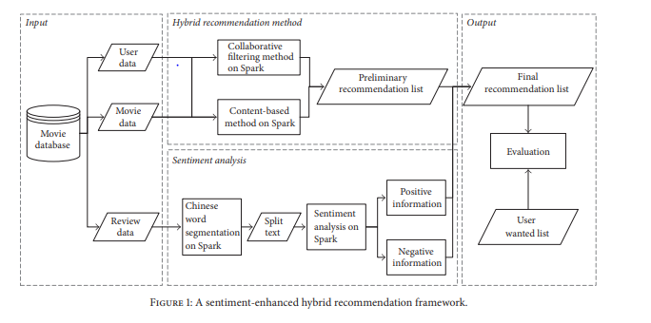
Existing System
The existing system determines ratings based on reviews and the dataset is in Chinese language. In this system, both hybrid recommendation and sentimental analysis are used.

Slide 7
Proposed system
The proposed system may contains only some Natural Language Processing procedures which helps to classify (positive, neutral, negative) the words containing in the review. It more efficient when compared to existing system.
It more efficient when compared to existing system.

Slide 8
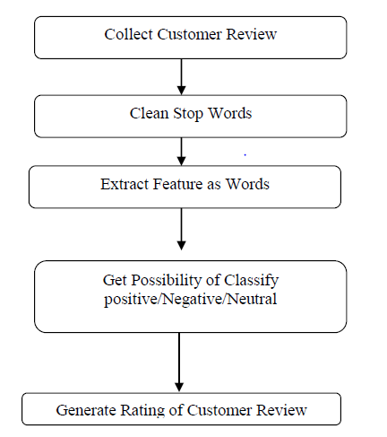
Cont…
Fig 2: A sentiment enhanced NLP framework

Slide 9
Cont… Advantages
This system uses only sentiment analysis methods which takes less time to produce results.
The Proposed System determines ratings for the reviews which are in Universal Language.
It takes less time to produce results by using NLP techniques where there is no use of Training datasets.

Slide 10
Cont… Disadvantages
This system uses both recommendation and sentiment analysis methods which takes more time to produce results.
The Existing System only determines ratings for the reviews which are in Chinese Language.

Slide 11
Process(Flow)
Input(.json)→Process(NLTK)→Output(Graphs)

Slide 12
Hardware and Software
Hardware Specification
Processor : 32/64 bit
RAM : 4GB or more
External Storage : Minimum 8GB
Software Specification
Operating System : Windows(7 and above)
Python : 2.7 and above versions
Tools : Jyputer Notebook

Slide 13
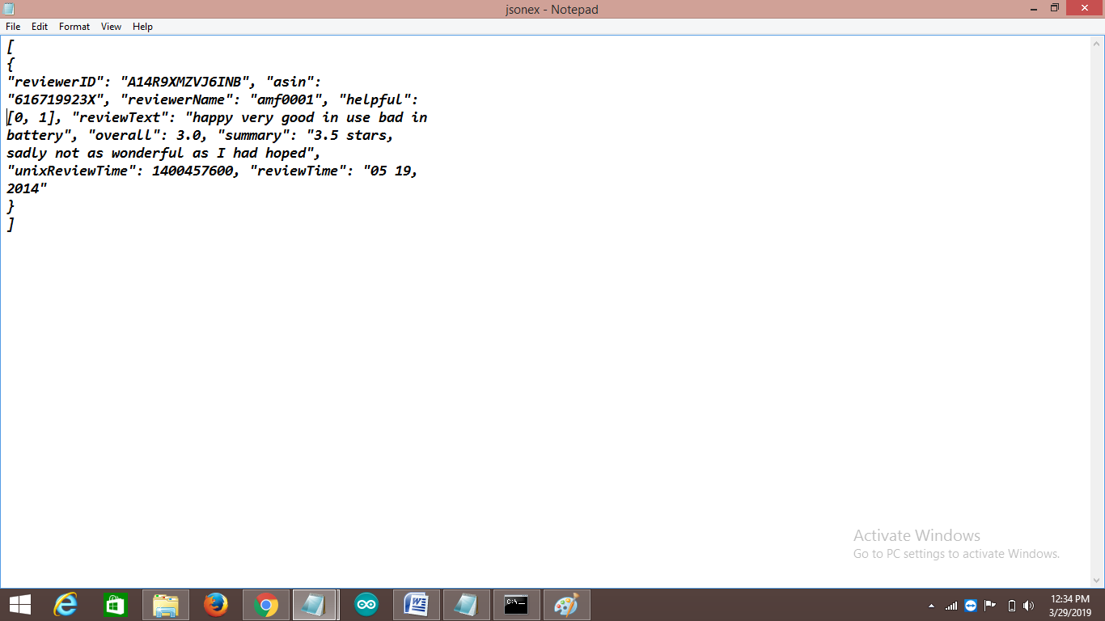
Sample Input
Fig 3: Sample input(.json) dataset

Slide 14
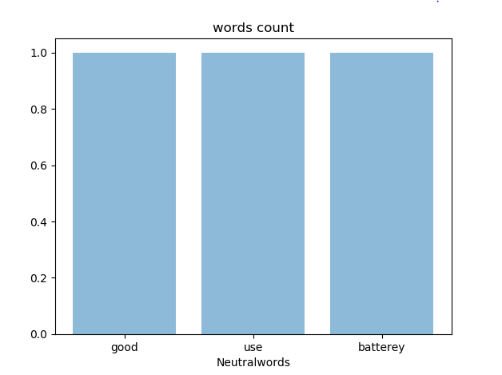
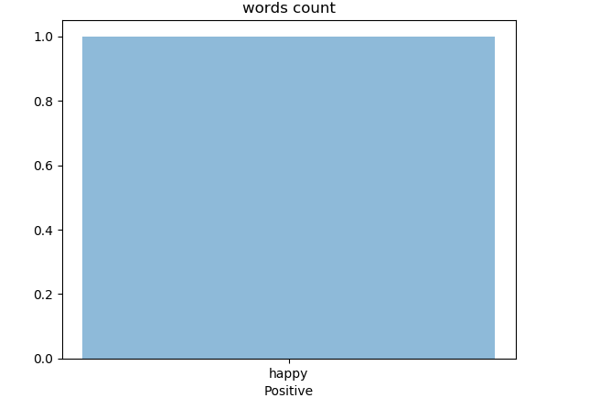
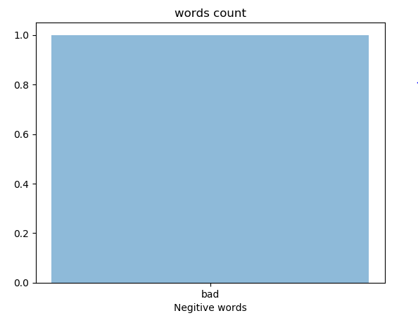
Sample outputs
Fig 4: Neutral words in a review review
Fig 5: Positive words in a review
Fig 6: Negative words in a review

Slide 15
Conclusion and Future work
In proposed work, we determined ratings based on reviews by using Natural Language Processing techniques. This helps to predict better ratings and efficient than recommended system algorithms, it also generate recommendations in quick manner and doesn’t required any training datasets.
In future, the work may extend by using NLP with K-Means, Decision Tree Algorithms which helps to perform more effective and produce efficient results.

Slide 16
References
[1] V. W. Zheng, B. Cao, Y. Zheng, X. Xie, and Q. Yang, Collaborative fltering meets mobile recommendation: a user-centered approach, in Proceedings of the 24th AAAI Conference on Artifcial Intelligence, pp. 236–241, 2010.
[2] V. W. Zheng, Y. Zheng, X. Xie, and Q. Yang, Towards mobile intelligence: learning from GPS history data for collaborative recommendation, Artifcial Intelligence, vol. 184/185, pp. 17–37, 2012.
[3] C. Ono, M. Kurokawa, Y. Motomura, and H. Asoh, A contextaware movie preference model using a bayesian network for recommendation and promotion, in Proceedings of 11th International Conference on User Modeling, pp. 247–257, 2007.
[4] M. Szomszor, C. Cattuto, H. Alani et al., Folksonomies, the semantic web, and movie recommendation, in Proceedings of 4th European Semantic Web Conference, pp. 1–14, 2007.

Slide 17
Cont…
[5] R. Armstrong, D. Freitag, T. Joachims, T. Mitchell, et al., WebWatcher: a learning apprentice for the world wide web, AAAI Spring symposium on Information gathering from Heterogeneous, distributed environments, (1995), pp. 6–12.
[6] L. Terveen, W. Hill, B. Amento, D. McDonald, J. Creter, PHOAKS: a system for sharing recommendations, Commun. ACM 40 (3) (1997) 59–62.
[7] H. Kautz, B. Selman, M. Shah, Referral web: combining social networks and collaborative filtering, Commun. ACM 40 (3) (1997) 63–65.
[8] T. Joerding, A temporary user modeling approach for adaptive shopping on the web, Proceedings of Second Workshop on Adaptive Systems and User Modeling on the World Wide Web, Toronto and Banff, Canada. Computer Science Report, (1999), pp. 99–107.
[9] B. Moore, R. Janker, B. Papez, L. Power, R. Watkins, Migrating weblogic applications to websphere advanced edition, IBM Redbooks, (2001), p. 1.

Slide 18
[10] J. L. Herlocker, J. Konstan, A. Borchers, and J. Riedl, An algorithmic framework for performing collaborative filtering, in Proceedings of the 22nd Annual International ACM SIGIR Conference on Research and Development in Information Retrieval (SIGIR ’99), pp. 230–237, Berkeley, Calif, USA, August 1999.
[11] Y. Koren, Collaborative filtering with temporal dynamics, Communications of the ACM, vol. 53, no. 4, pp. 89–97, 2010.
[12] T. Hofmann, Collaborative filtering via gaussian probabilistic latent semantic analysis, in Proceedings of the 26th International ACM SIGIR Conference on Research and Development in Information Retrieval (SIGIR), pp. 259–266, Toronto, Canada, 2003.

Slide 19
Queries

Slide 20
Thank You

